Slide 1
Enrollment Management
Advising Week for Spring 2013 begins October 22.
Joe’SS will be upgraded to v9.0 the weekend of November 16. Changes to Faculty access will be distributed in late October/early November.
Open House October 6 was a success. Thank you to everyone that participated.

Slide 2
Office of Graduate Studies
So far during the Fall 2012 semester, the Graduate Studies Specialists have completed the thesis/dissertation formatting checks and taken in the final library ready copy for 38 students. The deadline for submission of library ready T/D copy for FS12 is November 14th.

Slide 3
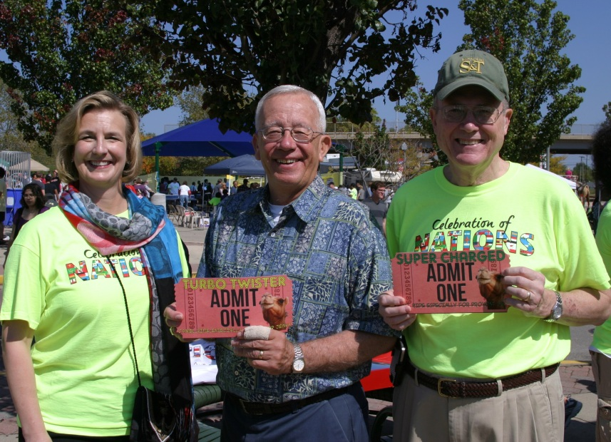
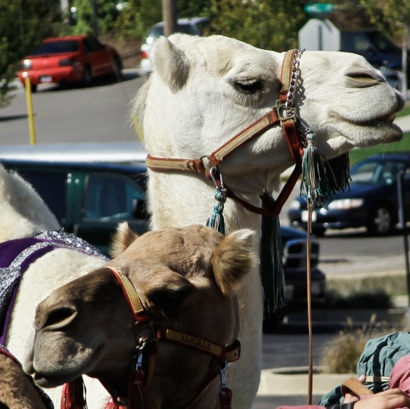
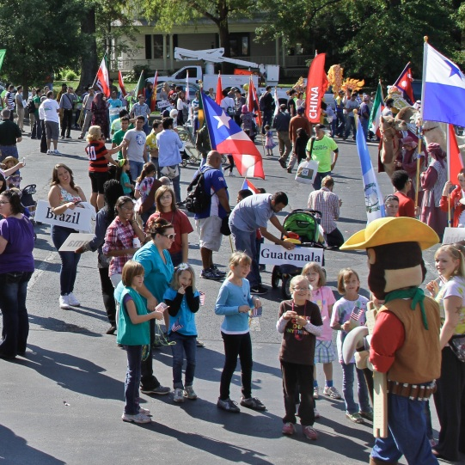
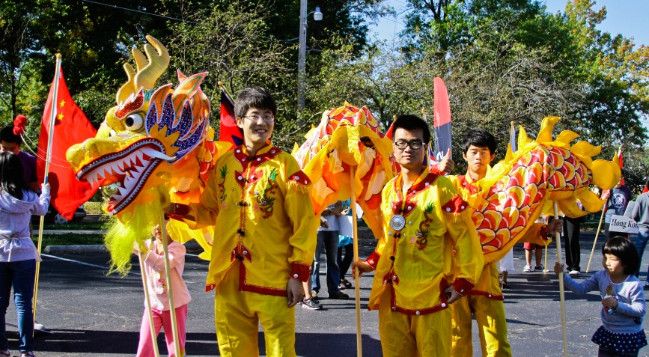
Celebration of Nations September 29, 2012
More than 65 countries represented
More than 2,000 in attendance
Community supported through donations
37 exhibitors – 26 student organizations
Parade included floats & marching bands
Successful International Idol competition
Outreach to local schools, Missouri State Fair & “Know Your World”, Fort Leonard Wood

Slide 4
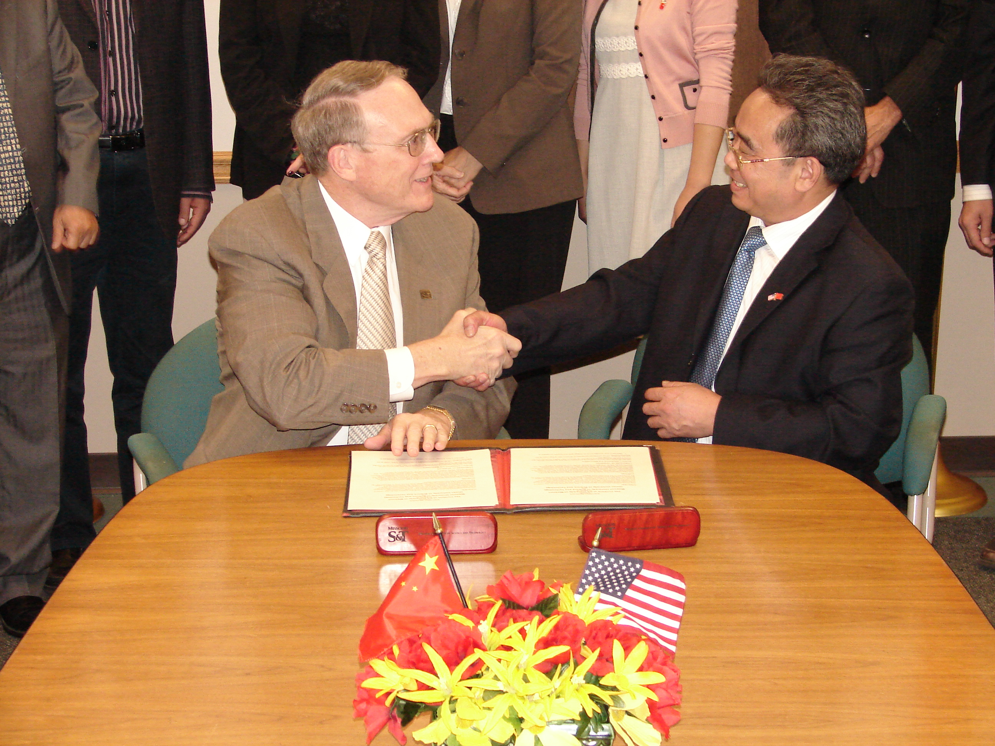
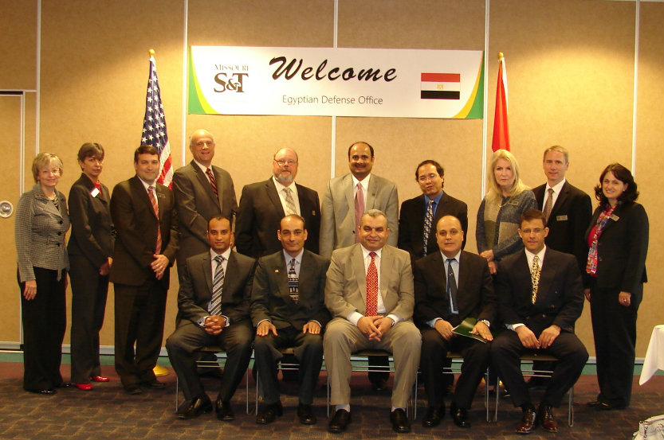
Office of International Affairs
International Delegation Visits:
Hunan University of Science & Technology (HUST) visited campus to sign an Articulation Agreement with Missouri S&T.
Representatives of the Egyptian Ministry of Defense visited campus to explore the expansion of a sponsored student program.
Memorandum of Understanding was signed with State Islamic University of Indonesia.
Memorandum of Understanding was signed with Reykjavik University, Iceland.

Slide 5
Office of International Affairs
Fall 2012 International Enrollment Statistics:
Total Enrollment: 1044 (954*)
Undergraduate: 262
Masters: 329
PhD: 356
(*includes on-campus, full-time, non-immigrants)
Total international enrollment has increased 2.05% from FS11 to FS12.
Total Number of Countries Represented: 61
Top 5 countries: China, India, Saudi Arabia, Libya, and Iran
(For the first time since the late 1990’s China has surpassed India as the top country of origin for S&T international students.)
Intensive English Program
Total Enrollment: 90 students (full & part-time)
Writing Workshop: 30 Students

Slide 6
Learning Enhancement Across Disciplines (LEAD)
Office of Undergraduate Studies
This is another banner semester for LEAD learning assistance (http://lead.mst.edu/assist). It has set FOUR new records:
63 different courses with LEAD learning assistance
50 courses with faculty-run LEAD Learning Centers
62 participating LEAD faculty associates
37 trained undergraduate Peer Learning Assistants
LEAD has matched two previous records
18 departments/degree programs with LEAD Learning Centers
29 courses provided with LEAD tutoring
Additionally, LEAD Learning Centers in introductory Chemistry and Physics have begun operating in the Residential College.
LEAD Director Ron Bieniek would like to thank the faculty and departments who are participants in LEAD’s success.

Slide 7
Office of Sponsored Programs
FY13 activities through the end of August and a year-over-year comparison are as follows:
Proposals awarded in total dollars: $29.4M (up 417.7%)
Number of proposals awarded and amendments: 51 (down 22.7%)
Proposals submitted in total dollars: $14.8M (down 37.1%)
Number of proposals submitted: 50 (down 29.6%)
Research expenditures: $9.1M (down 16.9%)
F&A recovered: $1.5M (down 12.8%)
Number of active awards: 588 (down 3.1%)
Notes:
7
Slide 1 – the 417.7% increase in new awards is because of the $23.4M award for the Saudi mining program.

Slide 8
Office of Sponsored Programs
Congratulations to Dr. John Singler, Assistant Professor of Mathematics and Statistics
Received a grant for $269,956 from National Science Foundation Computational Mathematics Program to:
Develop algorithms for complex partial differential equation models to construct
Simplified mathematical models
Feedback control laws
Prove accuracy guarantees for the algorithms
We want to know if we can trust the output of the algorithms for very complex problems
Notes:
Slide 2 & 3 – what is noteworthy is that there are two current awards from NSF Computational Mathematics program in the State of Missouri. Both faculty, John Singler and Yanzhi Zhang, are at S&T! John received his award in July 2012; Yanzhi received her award in September 2012.

Slide 9
Office of Sponsored Programs
Congratulations to Dr. Yanzhi Zhang, Assistant Professor of Mathematics and Statistics
Received a grant for $124,898 from National Science Foundation Computational Mathematics Program to:
Study instability of the split-step method (SSM) on spatially varying backgrounds
Propose more efficient and reliable modifications on SSM
Develop a systematic approach to study the stability in general
Apply the SSM to simulate fiber optic telecommunications and Bose-Einstein condensation

Slide 10
Vice Provost Office for Academic Affairs
2012 Faculty Excellence Award
17 Nominations
Committee reviewing to make final selection
UM Faculty Scholars Program
12 Applications received for participation in program

